Slide 1

English for Telephoning
Class: 18C1-NNA1
Time: 14.10 – 15.40 on Tuesday, 28th April, 2020
Lecturer: Ms. Nguyen Thi Thanh Tu
Faculty of Foreign Languages
Ly Tu Trong College of Ho Chi Minh City
Unit 2: Could you spell that for me?

Slide 2
Students have submitted the phoning call exercise
Phạm Quang Hiểu – Từ Hải Yến
Phạm Quang Hiểu – Nguyễn Giang Huy
Phạm Quang Hiểu - Phạm Thị Kim Chu
Phạm Quang Hiểu – Kiệt
Lê Thị Minh Phương – Đỗ Thị Quỳnh Như
Lương Thị Thùy Linh – Tăng Anh Toàn
Dương – Ngọc
Lê Cẩm Nhung – Thu Huyền
Hồng Hiếu – Quoc Vũ
Duyên Hải – Phạm Thanh Hùng
Trần Thị Trà My → good, alone?

Slide 3
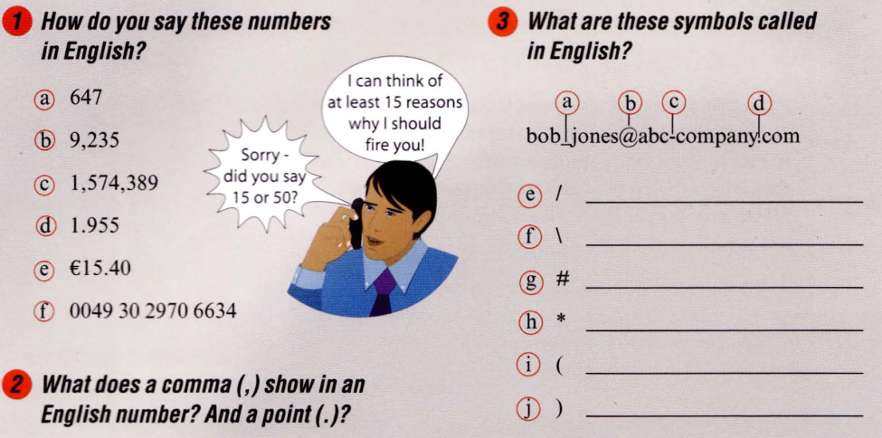
Hyphen/ dash
Underscore
at
dot
a/ 647 → Six hundred and forty-seven
b/ 9,235 → Nine thousand two hundred and thirty-five
c/ 1,574,389 → One million, five hundred and seventy-four
thousand, three hundred and eighty-nine
Forward/ slash
d/ 1.955 → One point nine five five
Back slash
e/ € 15.40 → fifteen euros and forty cents
Hash sign / pound sign/ number
f/ 0049 30 2970 6634 → oh oh (or zero zero) four nine three oh, two nine seven oh, double six ( or six six three four
asterisk
Open bracket
A comma shows the thousand position in a number.
A point shows the decimal place
Close bracket

Slide 4
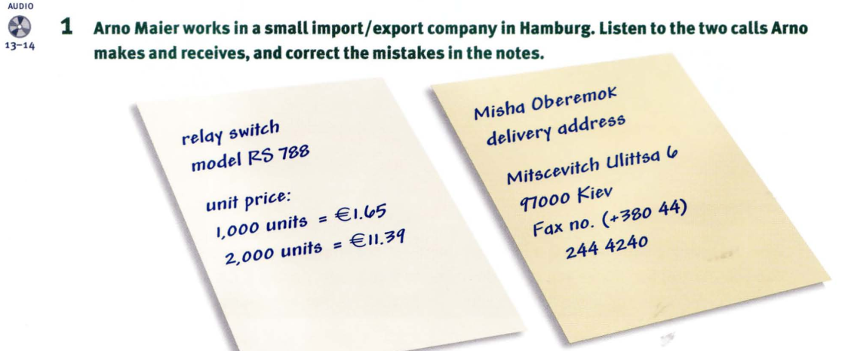
Track 13
Track 14
Relay switch
Model RS 788 877
Unit price:
1000 units = € 1.45 1.56
2000 units = € 11.39 1.49
Misha Oberemok
delivery address
Mitscevitch Ulittsa 6 Mitskevich Ulitsa
97000 Kiev 79000
Fax no. (+380 44)
244 4240 42 04

Slide 5
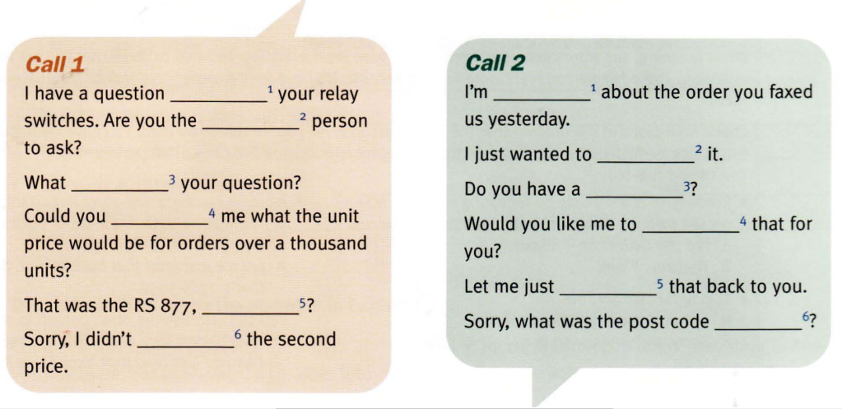
2. Listen to the dialogues again and complete the sentences and questions below.
Track 13
Track 14
about
calling
right
check
was
pen
tell
spell
read
right
catch
again

Slide 6
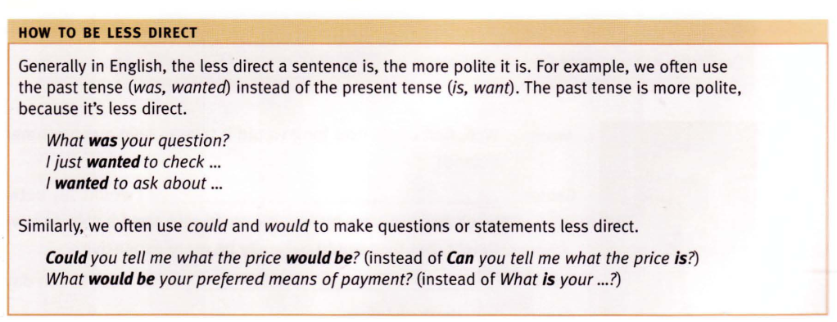

Slide 7
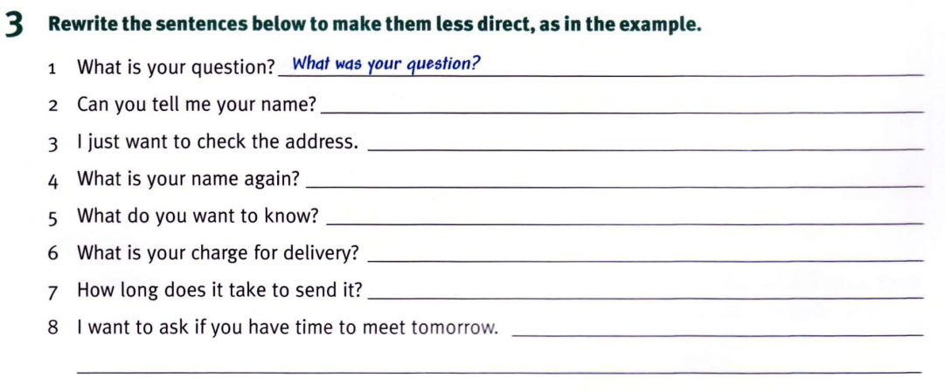
Could you tell me your name?
I just wanted to check the address.
What was your name again?
What did you want to do?
I just wanted to ask if you have time to meet tomorrow.
6/ Could you tell me what your charge for delivery would be?
7/ Could you tell me how long it would take to send it?

Slide 8
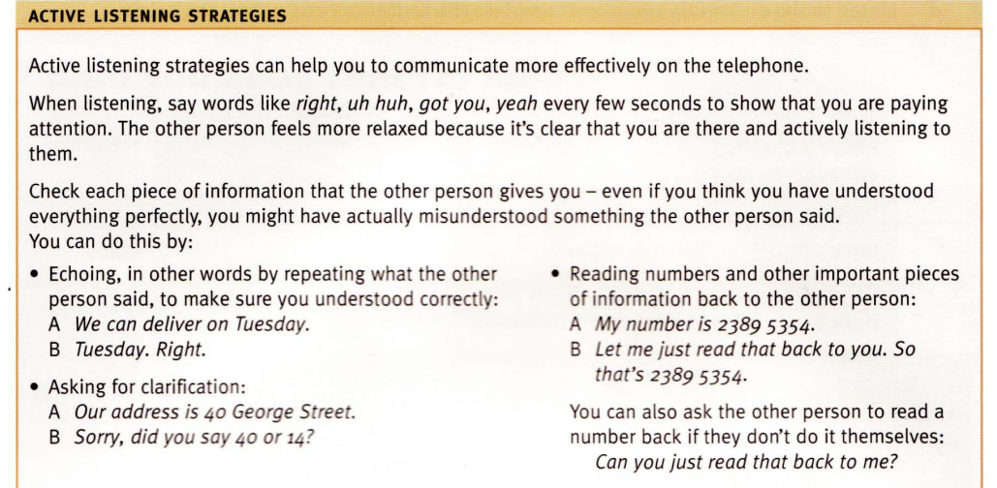

Slide 9
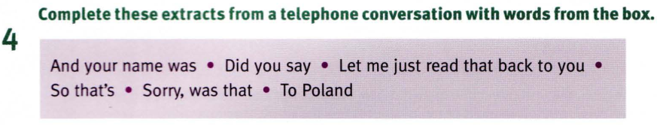
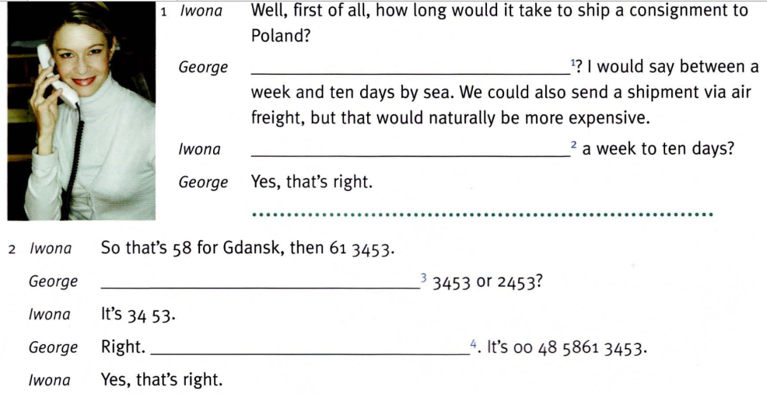
To Poland
Did you say
Sorry, was that
Let me just read that back to you

Slide 10
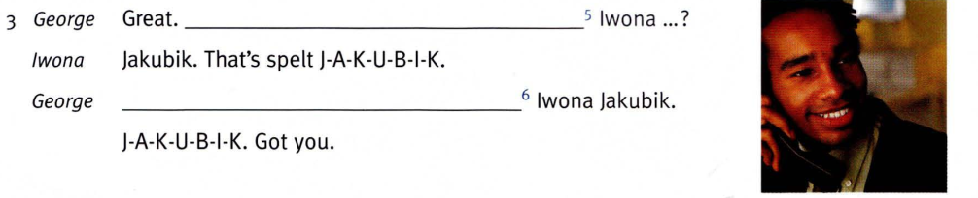
And your name was
So that’s

Slide 11
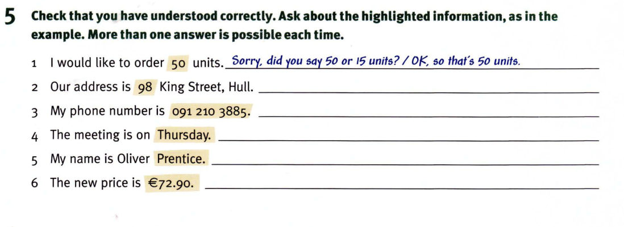
Sorry. Did you say 98 King Street?
Let me just read that back to you. Your number is 091 2103885
Thursday, right.
Prentice, right.
Sorry, did you say €72.90 or 72.19?

Slide 12
Homework:
After these two periods you have to remember vocabulary part ‘Active listening strategies’ and part 5.
- Students do exercises 5
- Sts read the tips.
Prepare for unit 2: Could you spell that for me? (cont.)

